Slide 1
Natural Language Processing (NLP) An introduction…
Dr. Ogerta Elezaj

Slide 2
Social Media Analytics
Social media platforms are a public ‘worldwide forum for expression’, where billions of people connect and share their experiences, personal views, and opinions
Social media isn’t just a place for individuals to connect with each other
Social media analytics- businesses have the opportunity to listen, monitor, and look in depth at these conversations and understand what people are saying online to make better-informed decisions.

Slide 3
Social Media Analytics vs. Social Media Monitoring vs. Social Media Intelligence
Social Media Analytics
The art and science of extracting valuable hidden insights from vast amounts of semi structured and unstructured social media data to enable informed and insightful decision making”
Social Media Monitoring
Tracking and gathering what the audience is saying on social media—a hashtag, a keyword, or other terms—about a brand or its competitors.
Social Media Intelligence
Monitoring social media, collecting and analyzing the content, and using the resulting insights to inform strategy

Slide 4
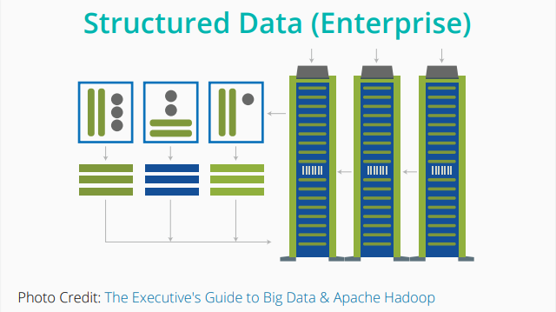
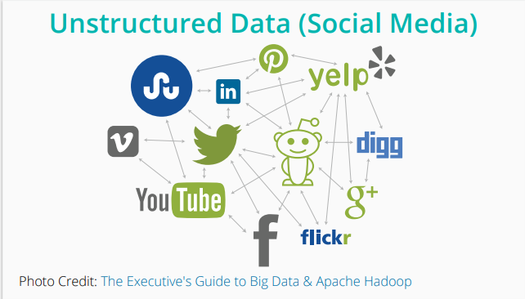
Data

Slide 5
Unstructured data
Why bother to extract this unstructured data?
It can yield deeper insights.
Examples: identifying issues, market trends, or overall customer sentiment towards a brand

Slide 6
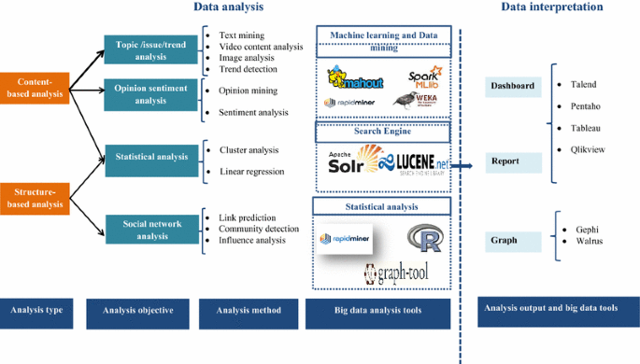
Social Big Data analysis steps

Slide 7
Natural Language Processing (NLP)

Slide 8
Natural Language Processing (NLP)
A subfield of linguistics, computer science and artificial intelligence concerned with interactions between computers and human (natural) languages. It is used to apply machine learning algorithms to text and speech.
Problem: how to program computers to process and analyse large amounts of natural language data.
Challenge: dealing with unstructured data.
Ultimate Goal: give the machines the ability to read, understand and derive meaning from human languages.

Slide 9

Applications of NLP(1)
Sentiment Analysis
Organizations can determine what customers are saying about a service or product by identifying and extracting information in sources like social media. This sentiment analysis can provide a lot of information about customers choices and their decision drivers.

Slide 10
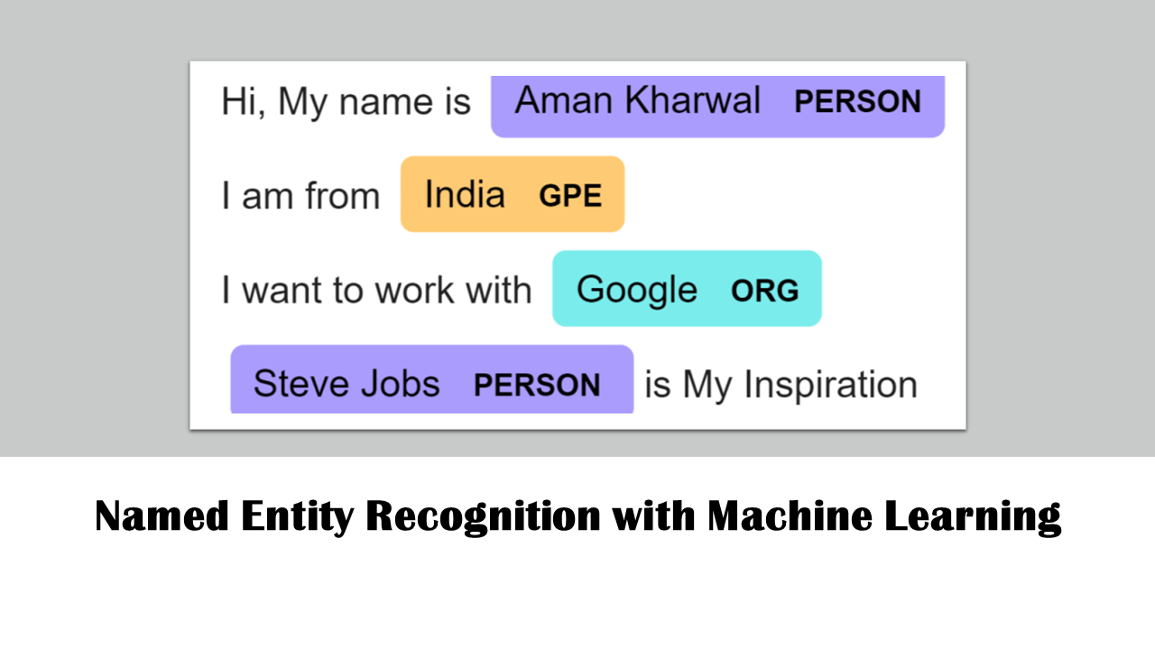
Applications of NLP(2)
Named Entity Recognition (NER)
locate and classify named entities in text into pre-defined categories such as the names of persons, organizations, locations, expressions of times, quantities, monetary values, percentages, etc.
NER is used in many fields in Natural Language Processing (NLP)

Slide 11
Applications of NLP(3)
Machine Translation
Machine Translation (MT) or automated translation refers to the process when computer software translates a text from the source language into the target language without human intervention.
There are three types of machine translation methods, described here in simple terms:
Rules-based machine translation uses grammar and language rules that have been developed by language experts, as well as customized dictionaries
Statistical machine translation learns how to translate by analyzing a large number of existing human translations
Neural machine translation teaches itself how to translate by using a large neural network. This method is becoming increasingly popular as it often provides the best results.

Slide 12

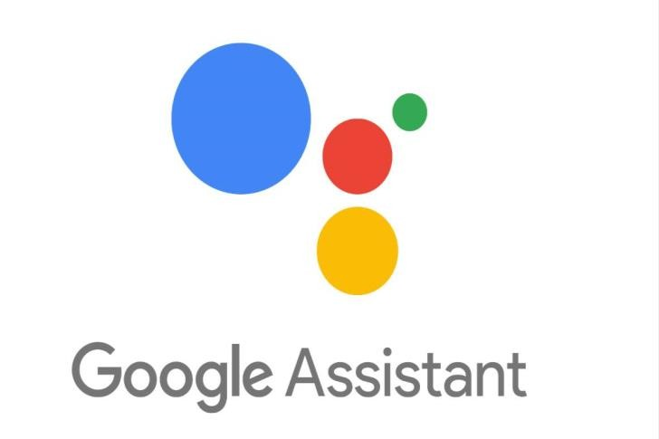

Applications of NLP(4)

Slide 13
Applications of NLP(5)
Spam Detection,
Autocomplete and Predictive Typing,
Matching resumes to job opportunities
Disease Prediction in Healthcare,
And many more…

Slide 14

Basic Concepts of NLP (Terminology)
Text corpus or corpora: A large set of text data that can be in one of the languages like English, French, and so on.
Paragraph: Largest unit of text handled by an NLP task
Sentences: A sentence encapsulates a complete meaning or thought and context. It is usually extracted from a paragraph based on boundaries determined by punctuations like period.
Phrases and Words: The smallest unit of text is word.
Corpus
Sentence
Word
Paragraph

Slide 15
Text Pre-Processing
Text pre-processing is the process of preparing and manipulating textual data to use them in data analytics tasks.
Sentence Tokenization
Word Tokenization
Text Lemmatization and Stemming
Stop Words
Regex

Slide 16
Sentence Tokenization
Sentence tokenization (also called sentence segmentation) is the problem of dividing a string of written language into its component sentences. The idea here looks very simple.
In English and some other languages, we can split apart the sentences whenever we see a punctuation mark.
It’s not that simple.
Hello Mr. Smith, How are you? My name is Alex. I love to learn Python.

Slide 17
Word Tokenization
Word tokenization (also called word segmentation) is the problem of dividing a string of written language into its component words. In English and many other languages using some form of Latin alphabet, space is a good approximation of a word divider.
In English and many other languages using some form of Latin alphabet, space is a good approximation of a word divider.

Slide 18
Text Lemmatization and Stemming
For grammatical reasons, documents can contain different forms of a word such as drive, drives, driving. Also, sometimes we have related words with a similar meaning, such as nation, national, nationality.
Lemmatization: It involves resolving words to their dictionary form. In fact, a lemma of a word is its dictionary or canonical form.
Stemming: is the process of reducing inflection in words to their root forms.
The goal of both stemming and lemmatization is to reduce various forms of a word to a common base form.
Word | Lemma. | Stemming
Studies | Study | Studi
Studying | Study | Study

Slide 19
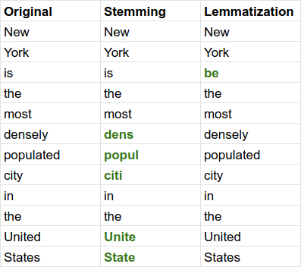
Stemming vs. Lemmatization
Stemming uses the stem of the word
Lemmatization uses the context in which the word is being used.

Slide 20
Porter’s algorithm The most common English stemmer
Step 1a
sses → ss caresses → caress
ies → i ponies → poni
ss → ss caress → caress
s → ø cats → cat
Step 1b
(*v*)ing → ø walking → walk
sing → sing
(*v*)ed → ø plastered → plaster
…
Step 2 (for long stems)
ational→ ate relational→ relate
izer→ ize digitizer → digitize
ator→ ate operator → operate
…
Step 3 (for longer stems)
al → ø revival → reviv
able → ø adjustable → adjust
ate → ø activate → activ
…

Slide 21
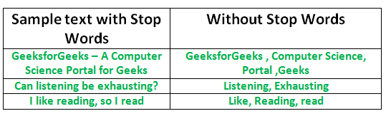
Stop words
Stop words are words that don’t have much value in terms of meaning and need to be filtered out before (or sometimes after) processing of text. When applying machine learning to text, these words can add a lot of noise.
We want to remove these irrelevant words that does not carry a lot of meaning.
Examples of stop word: it, is, and, a, am, are, etc.

Slide 22
Feature Extraction and Word Embedding Techniques

Slide 23
Feature Extraction From Text
Machine learning algorithms cannot work with raw text directly, we need to convert the text into vectors of numbers. This is called feature extraction.
Feature extraction aims to transfer raw data into meaningful alignments.
Bag Of Words (BOW)
TF-IDF
Word Embedding
Word2Vec
GloVe

Slide 24
Bag Of Words (BOW)
BOW: A way of extracting features from text for use in modeling, such as with machine learning algorithms.
The approach is very simple and flexible, and can be used in a various applications related to extracting features from documents.
A bag-of-words is a representation of text that describes the occurrence of words within a document. It involves two things:
A vocabulary of known words.
A measure of the presence of known words.

Slide 25
Bag Of Words (contd.)
It is called a “bag” of words, because any information about the order or structure of words in the document is discarded. The model is only concerned with whether known words occur in the document, not where in the document.
Example: Suppose we have the following reviews for a hotel:
-Good hotel -Not a good hotel -Best hotel in the area
The first step towards BOW is to identify all the unique words from the above set of reviews.
That would be: (good, hotel, not, a, best, in, the, area)

Slide 26
Bag Of Words (contd.)
good | hotel | not | a | best | in | the | area
1 | 1 | 0 | 0 | 0 | 0 | 0 | 0
1 | 1 | 1 | 1 | 0 | 0 | 0 | 0
0 | 1 | 0 | 0 | 1 | 1 | 1 | 1

Slide 27
Term Frequency–Inverse Document Frequency (TF-IDF)
TF-IDF stands for term frequency-inverse document frequency. It highlights a specific issue which might not be too frequent in our corpus but holds great importance.
The TF–IDF value increases proportionally to the number of times a word appears in the document and decreases with the number of documents in the corpus that contain the word.
It is composed of 2 sub-parts :
Term Frequency (TF)
Inverse Document Frequency (IDF)

Slide 28
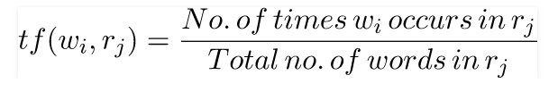
TF-IDF (contd.)
Term Frequency(TF) :
Term frequency specifies how frequently a term appears in the entire document. It can be thought of as the probability of finding a word within the document.
Consider a document containing 100 words wherein the word cat appears 3 times. The TF for the word ‘cat’ is then 3/100 = 0.03

Slide 29
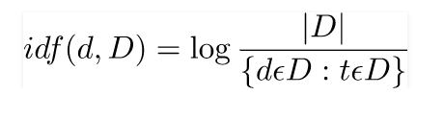
TF-IDF (contd.)
Inverse Document Frequency(IDF) :
The inverse document frequency is a measure of whether a term is rare or frequent across the documents in the entire corpus. It highlights those words which occur in very few documents across the corpus, or in simple language, the words that are rare have high IDF score. IDF is a log normalised value, that is obtained by dividing the total number of documents D in the corpus by the number of documents containing the term t, and taking the logarithm of the overall term.
Now, assume we have 10 million documents and the word cat appears in one thousand of these. Then, the inverse document frequency (i.e., idf) is calculated as log(10,000,000 / 1,000) = 4.
Thus, the TF-IDF weight is the product of these quantities: 0.03 * 4 = 0.12.

Slide 30
TF-IDF (contd.)
Given the previous example of hotel reviews, we can now use the weight of each words instead of using only zeros and ones.
This technique copes with the first drawback of BOW that we have talked about:
Words with higher frequency becomes dominant in the data.
good | hotel | not | a | best | in | the | area
0.5 * log(3/2) = 0.1 | 0.5 * log(3/3) = 0 | 0 | 0 | 0 | 0 | 0 | 0
First Review

Slide 31
N-gram
An n-gram model is a type of probabilistic language model for predicting the next item in such a sequence in the form of a (n − 1) order.
Statistical language models, in its essence, are the type of models that assign probabilities to the sequences of words.
P(w|h), the probability of a word w given some history h.
Suppose the history h is “the cat jumps” and we want to know the probability that the next word is ‘over’:
P(over | the cat jumps)
n-grams of texts are extensively used in text mining and natural language processing tasks.

Slide 32
N-gram (contd.)
n-gram is a contiguous sequence of n items (words, letters, numbers) from a given sample of text or speech.
In the context of a corpora, n-gram typically refers to words.
A unigram is one word, A bigram is two words, and trigram is three words.
Example: ‘Birmingham City University has four faculties’
Bigrams (2-gram): ‘Birmingham City’, ‘City University’, ‘University has’, ‘has four’, ‘four faculties’
Trigrams (3-gram): ‘Birmingham City University’, ‘City University has’, ‘University has four’, ‘has four faculties’
5-gram: ‘Birmingham City University has four’, ’City University has four faculties’

Slide 33
N-gram (contd.)
N-grams are used for a variety of different task.
For instance, when developing a language model, n-grams are used to develop unigram models as well as bigram and trigram models.
Google and Microsoft have developed web scale n-gram models that can be used in a variety of tasks such as spelling correction, word breaking and text summarization.
Here is a publicly available web scale n-gram model by Microsoft: http://research.microsoft.com/en- us/collaboration/focus/cs/web-ngram.aspx
Here is a paper that uses Web N-gram models for text summarization:Micropinion Generation: An Unsupervised Approach to Generating Ultra-Concise Summaries of Opinions

Slide 34
Word Embedding
Traditional feature extraction techniques (e.g. BoW, TF-IDF) do not take into consideration the semantic relationship between different words. (don’t understand how similar/dissimilar are terms in a text).
For example, the terms ‘good’, ‘well’ and ‘nice’ have approximately similar semantic meaning and can be used interchangeably. Traditional feature extraction techniques are not able to take relate them to each other.
Word Embedding is a representation of text where words that have the same meaning have a similar representation. In other words it represents words in a coordinate system where related words, based on a corpus of relationships, are placed closer together.

Slide 35
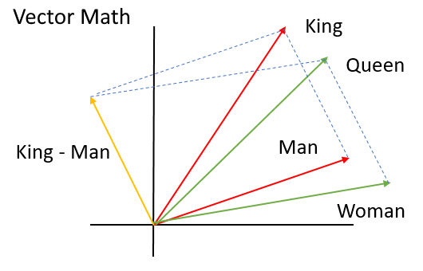

Word Embedding (contd.)
The idea of word embedding techniques is to map different words to their corresponding vectors in a way that similar terms are closer to each other in a meaningful mechanism.
The goal is:

Slide 36
Word2Vec
Word2Vec is one of the most popular techniques used to construct word embeddings.
The models created by using word2vec are shallow two-layer neural networks.
Word2Vec can be obtained using two methods (both involving Neural Networks): Skip Gram and Common Bag Of Words (CBOW)
CBOW Model takes the context of each word as the input and tries to predict the word corresponding to the context.
Skip-gram is one of the unsupervised learning techniques used to find the most related words for a given word. Skip-gram is used to predict the context word for a given target word.
CBOW and Skip-gram models aim to find the most related words for a given word.

Slide 37
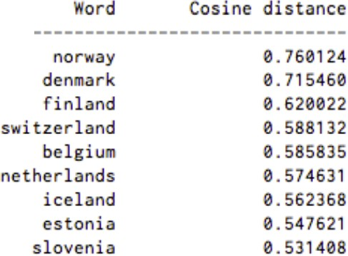
Word2vec

Slide 38
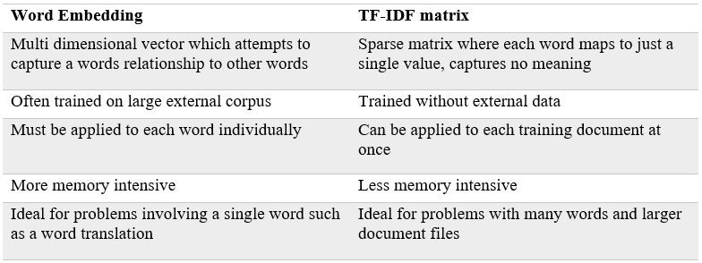
Word Embedding vs TF-IDF matrix

Slide 39
Word embedding model using pre-trained models
If our dataset size is small, we can't provide enough sentences, then our model will not learn more from our dataset. Otherwise if we want to build a word2vec model with a large corpus then it will require more resources like time, memory etc.
So how can we build a better word embedding model in this situation? we can utilize already trained models such as the following models.
GloVe (Global Vector Representation)
You can download this pretrained model from this link.
BERT (Bidirectional Encoder Representations)
You can download google BERT pretrained model from this link.

